Slide 1
Fundamentals of Neural Networks
Curriculum module
Primož Potočnik
University of Ljubljana
Faculty of Mechanical Engineering
primoz.potocnik@fs.uni-lj.si

Slide 2
Description
This teaching package contains modular contents for the introduction of the fundamentals of Neural Networks.
The package consists of a series of MATLAB Live Scripts with complementary PowerPoint presentations.
The package is intended to gradually guide the students toward basic concepts in neural networks through general demonstrations applicable to every field, spanning from science to engineering.
The contents are mainly addressed towards undergraduate courses, however, the modular structure allows further integration within other (postgraduate) AI-based courses. Course application areas include Neural Networks, Deep Learning, Machine Learning, Industrial Diagnostics and Condition Monitoring, and Autonomous Systems.

Slide 3
Instructions
The teaching materials can be approached either by following the Live Scripts or the PowerPoint presentations
Start with opening the introductory Live Script
NN0b_Contents_and_instructions.mlx
or the introductory presentation (this presentation)
NN0a_Contents_and_instructions.pptx
and follow the presentation
Each PowerPoint presentation provides links to the complementary Live Script examples

Slide 4
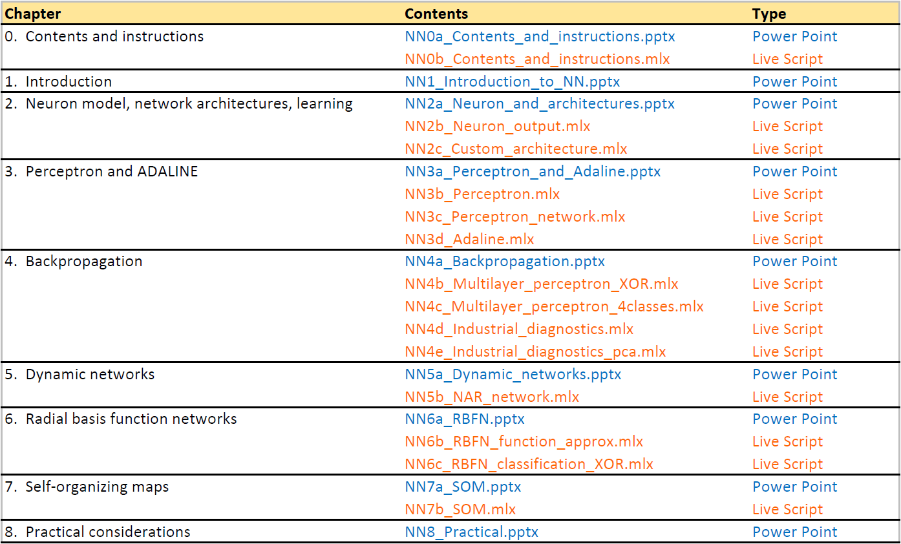
Contents

Slide 5
PowerPoint presentations
NN0a_Contents_and_instructions.pptx
NN1_Introduction_to_NN.pptx
NN2a_Neuron_and_architectures.pptx
NN3a_Perceptron_and_Adaline.pptx
NN4a_Backpropagation.pptx
NN5a_Dynamic_networks.pptx
NN6a_RBFN.pptx
NN7a_SOM.pptx
NN8_Practical.pptx

